Slide 1
SAVE LIFE
SEARCH AND ORDER THE BLOOD
FOR SAVE LIFE

Slide 2

City University Department Of CSE
Batch:39th
NAME: ID:
Mirajul-Islam 152392319
Mahabubul Alam 152392309
Md. Tanvir Hossain 152392321
Tanvir Hasan 153402310

Slide 3
Brainstorming
1.Wallet Tracking
2.Traffic Control Room
3.Save life

Slide 4
Here We choose Save Life

Slide 5
Save life
Why we choose save life??
1.Very needed at present time.
2.Easy to use.
3.Build Cost is low.
4.It has both web and apps.
5.It’s based on social media.

Slide 6
PURPOSE:
The purpose is to meet the challenging requirement of modern day blood to efficiently collect blood during emergency.
SCOPE:
This system presents an alert system to the donor about requirement of their blood to a person in need and also provides online status of blood group wise availability of blood units in all the licensed blood banks in the state.

Slide 7
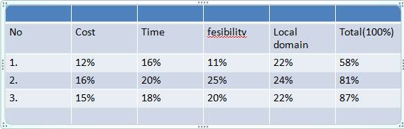
Priority Matrix

Slide 8
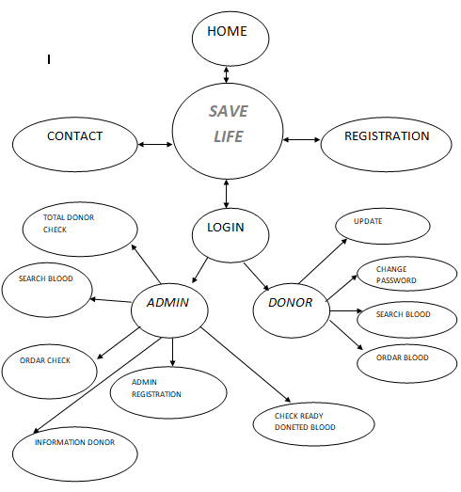
Concept Mapping

Slide 9







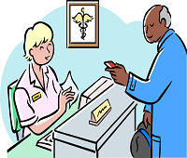




Slide 10

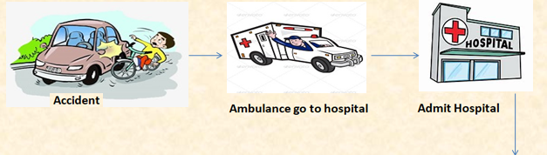
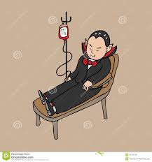
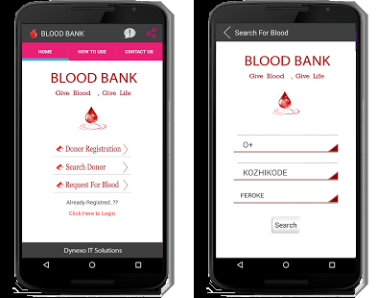

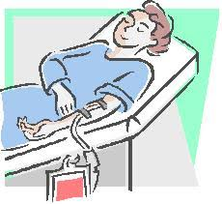


Slide 11
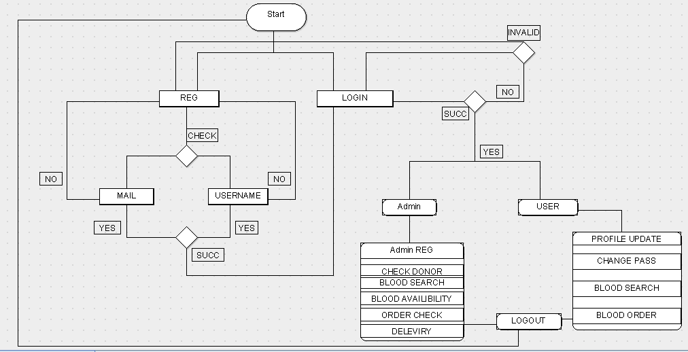
Activity Diagram

Slide 12
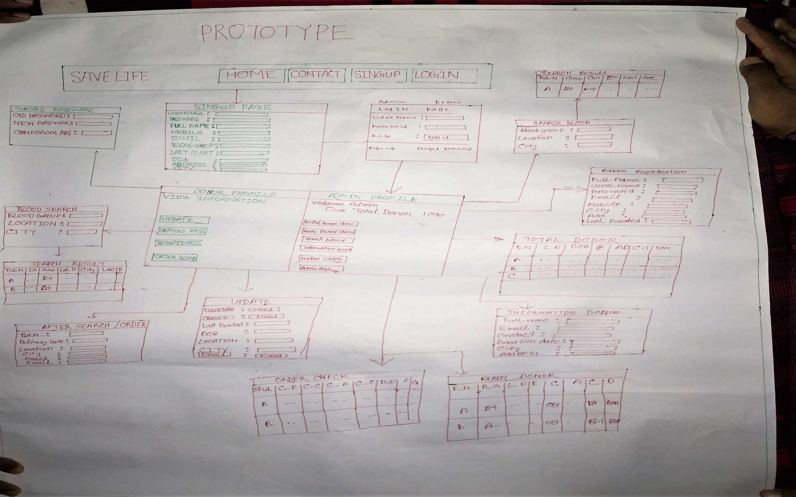
Prototype

Slide 13
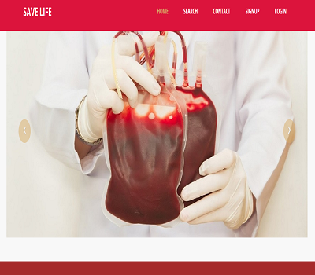
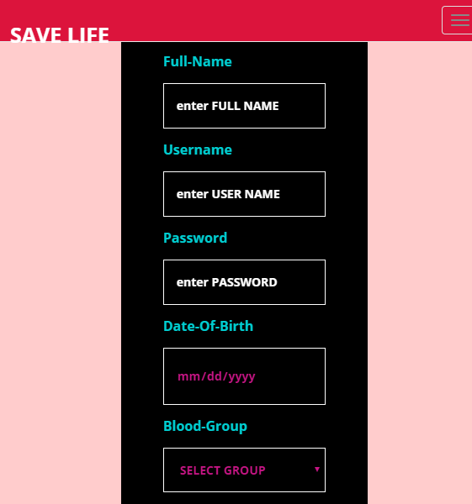
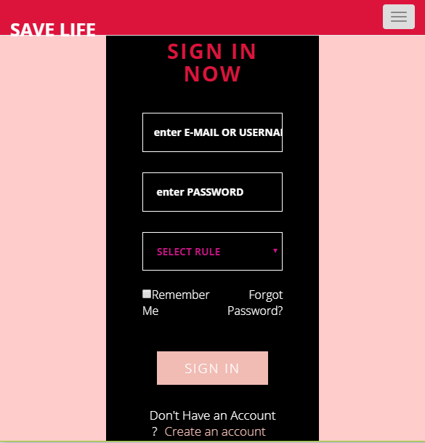


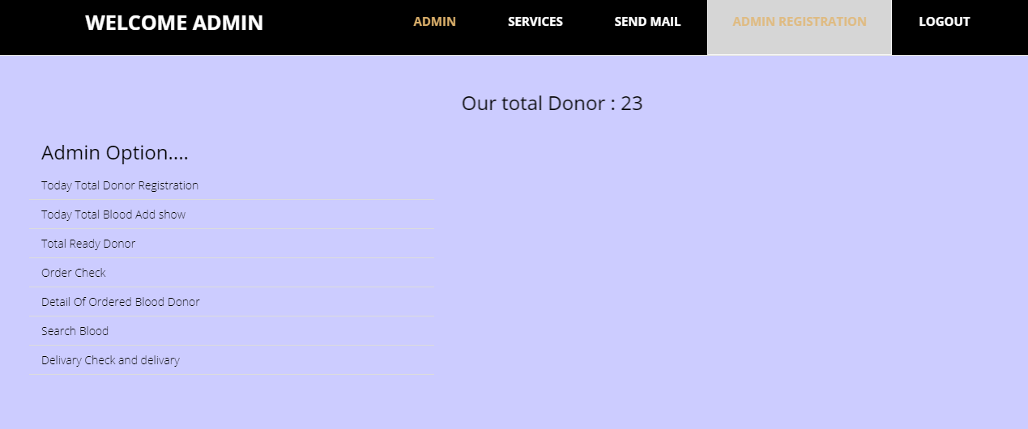
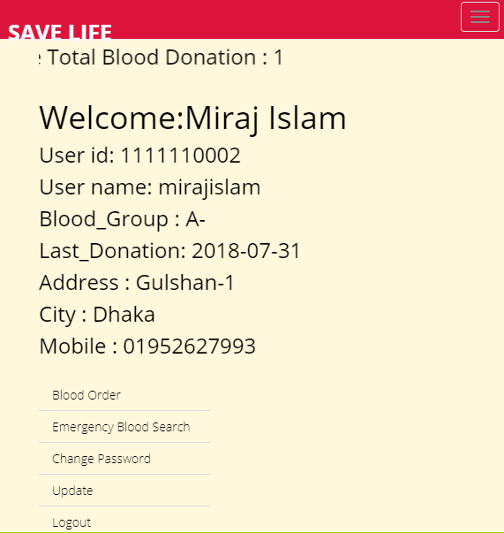
Prototype Website

Slide 14
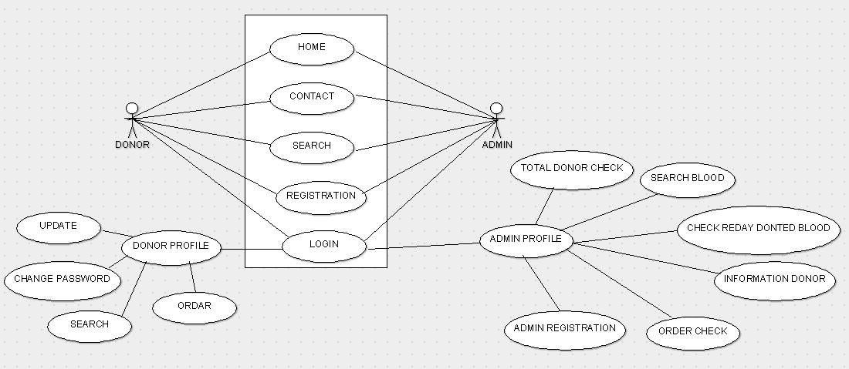
USE CASE DIAGRAM

Slide 15
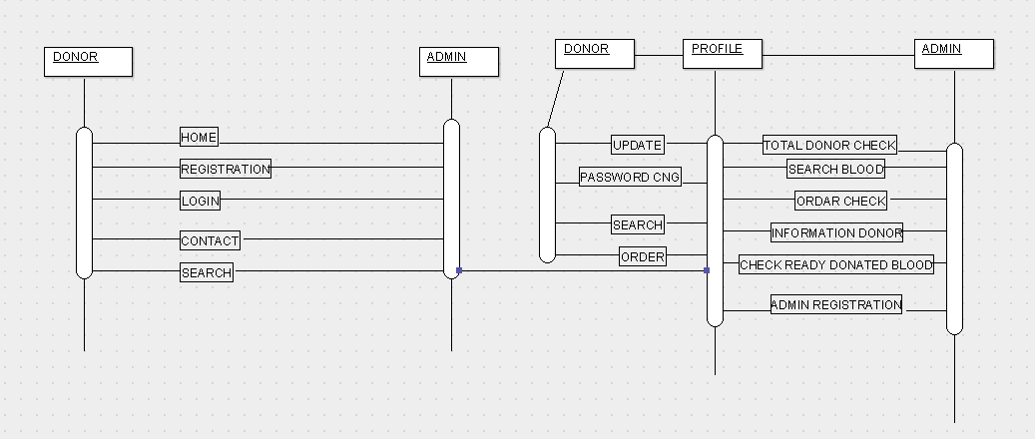
SEQUENCE DIAGRAM

Slide 16
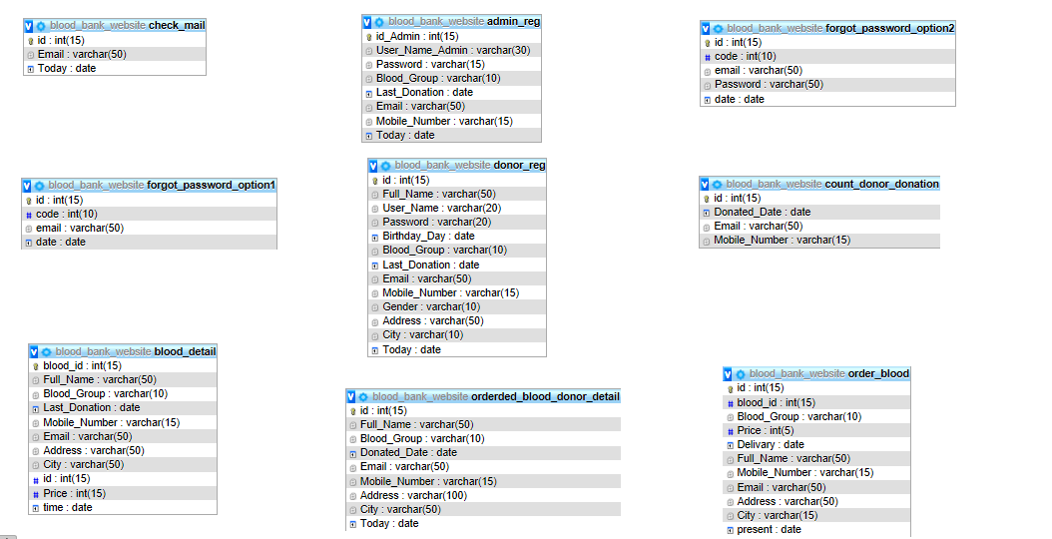
DATABASE TABLE

Slide 17
HOW I DO
This section provides you with information and online services to avail various Citizen Services being provided through this website. The list, however, is not exhaustive, as we are committed to adding more other online services into this website. Keep visiting this section for new updates!!
Check availability of blood stocks.
Online registration of blood donor.
Check the status of issued blood.

Slide 18
Every Blood Donor Is A Hero

